Slide 1

Chapter 6
Intermediate Code Generation

Slide 2
Introduction
Intermediate code is the interface between front end and back end in a compiler
Ideally the details of source language are confined to the front end and the details of target machines to the back end (a m*n model)
Parser
Static
Checker
Intermediate Code Generator
Code Generator
Front end
Back end

Slide 3
Variants of syntax trees
It is sometimes beneficial to crate a DAG instead of tree for Expressions.
A directed acyclic graph (hereafter called a DAG) for an expression identifies the common sub expressions (sub expressions that occur more than once) of the expression.
This way we can easily show the common sub-expressions and then use that knowledge during code generation
Example: a+a*(b-c)+(b-c)*d

Slide 4
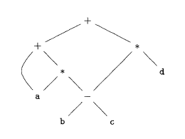
DAG
a+a*(b-c)+(b-c)*d
+
+
a
*
*
-
-
a
d
b
c
b
c

Slide 5
SDD for creating DAG’s
Production
Semantic Rules
E -> E1+T
E -> E1-T
E -> T
T -> (E)
T -> id
T -> num
E.node= new Node(‘+’, E1.node,T.node)
E.node= new Node(‘-’, E1.node,T.node)
E.node = T.node
T.node = E.node
T.node = new Leaf(id, id.entry)
T.node = new Leaf(num, num.val)

Slide 6
Value-number method for constructing DAG’s
=
1
id
To entry for i
2
num
10
+
3
+
1
2
4
=
1
3
i
10
Algorithm
  Search the array for a node M with label op, left child l and right child r
  If there is such a node, return the value number M
  If not create in the array a new node N with label op, left child l, and right child r and return its value
We may use a hash table

Slide 7
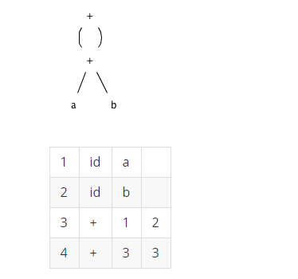
Example
Construct the DAG and identify the value numbers for the subexpressions of the following expressions, assuming + associates from the left.
a+ b+ (a+ b).

Slide 8
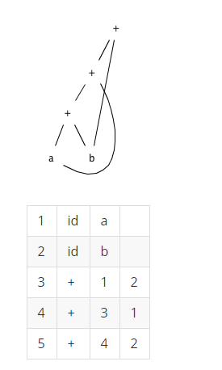
Example
b) a+b+a+b

Slide 9
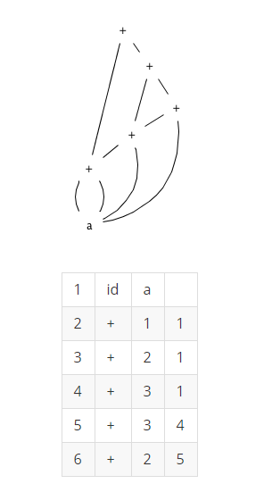
Example
C) a+a+(a+a+a+(a+a+a+a))

Slide 10
Three address code
Three-address code is a linearized representation of a syntax tree or a DAG in which explicit names correspond to the interior nodes of the graph
In a three address code there is at most one operator at the right side of an instruction
Example:
t1 = b – c
t2 = a * t1
t3 = a + t2
t4 = t1 * d
t5 = t3 + t4

Slide 11
Forms of three address instructions
Assignment instructions of the form x = y op z, where op is a binary arithmetic or logical operation, and x, y, and z are addresses.
Assignments of the form x = op y, where op is a unary operation. Essential unary operations include unary minus, logical negation, shift operators, and conversion operators that, for example, convert an integer to a floating-point number.
Copy instructions of the form x = y, where x is assigned the value of y.
An unconditional jump goto L. The three-address instruction with label L is the next to be executed.
Conditional jumps of the form i f x goto L and if False x goto L2. These instructions execute the instruction with label L next if x is true and false, respectively. Otherwise, the following t hree-address instruction in sequence is executed next, as usual.

Slide 12
Forms of three address instructions
Conditional jumps such as if x relop y goto L, which apply a relational operator (<, ==, >=, etc.) to x and y, and execute the instruction with label L next if x stands in relation relop to y. If not, the three-address instruction following i f x relop y goto L is executed next, in sequence.
Procedure calls and returns are implemented using the following instructions: param x for parameters; callp, n and y = callp, n for procedure and function calls, respectively; and return y, where y, representing a returned value, is optional. Their typical use is as the sequence of threeaddress instructions.

Slide 13
Example
do i = i+1; while (a[i] < v);
L: t1 = i + 1
i = t1
t2 = i * 8
t3 = a[t2]
if t3 < v goto L
100: t1 = i + 1
101: i = t1
102: t2 = i * 8
103: t3 = a[t2]
104: if t3 < v goto 100
Symbolic labels
Position numbers

Slide 14
Data structures for three address codes
The description of three-address instructions specifies the components of each type of instruction, but it does not specify the representation of these instructions in a data structure. In a compiler, these instructions can be implemented as objects or as records with fields for the operator and the operands.
Quadruples
  Has four fields: op, arg1, arg2 and result
Triples
  Temporaries are not used and instead references to instructions are made
Indirect triples
  In addition to triples we use a list of pointers to triples

Slide 15
Example
Three address code
t1 = minus c
t2 = b * t1
t3 = minus c
t4 = b * t3
t5 = t2 + t4
a = t5
b * minus c + b * minus c
Quadruples
Triples
Indirect Triples
op
arg1
arg2
result
op
arg1
arg2
op
op
arg1
arg2
minus
c
t1
0
minus
c
35
(0)
0
minus
c
*
b
t1
t2
1
*
b
(0)
36
(1)
1
*
b
(0)
minus
c
t3
2
minus
c
37
(2)
2
minus
c
*
b
t3
t4
3
*
b
(2)
38
(3)
3
*
b
(2)
+
t2
t4
t5
4
+
(1)
(3)
39
(4)
4
+
(1)
(3)
=
t5
a
5
=
a
(4)
40
(5)
5
=
a
(4)

Slide 16
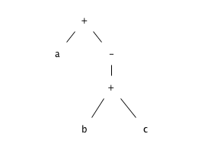
Example
Translate the arithmetic expression a + -(b + c) into:
a) A syntax tree.
b) Quadruples.
c) Triples.
d) Indirect triples.

Slide 17
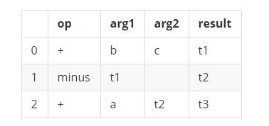
Quadruples

Slide 18
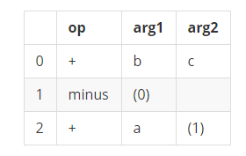
Triples

Slide 19
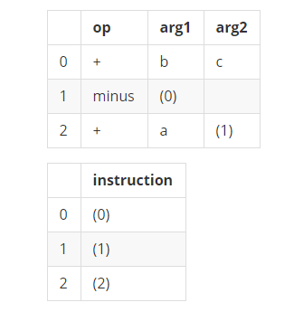
Indirect triples.

